Slide 1
CLIMATE CHANGE

Slide 2
Abstract
Climate change is one of the major challenges of our time and adds considerable stress to our societies and to the environment. From shifting weather patterns that threaten food production, to rising sea levels that increase the risk of catastrophic flooding, the impacts of climate change are global in scope and unprecedented in scale. the associated terms, causes, consequences, solutions and its potential health impact. It shows the need to act urgently if we are to avoid an irreversible build-up of greenhouse gases (GHGs) and global warming at a potentially huge cost to the economy and society worldwide . Therefore, addressing climate change requires an unprecedented level of cooperation.

Slide 3
Introduction
The evidence of climate change is compelling: sea levels are rising, glaciers are retreating, precipitation patterns are changing, and the world is getting warmer. According to the Intergovernmental Panel on Climate Change (IPCC), the current rate of greenhouse gas emissions is likely to cause average temperatures to rise by 0.2˚C per decade. Climate change indeed is real. Super typhoon Haiyan is the latest natural disaster that has also led credence to the reality of climate change. This sad occurrence hit land and devastated the Philippines. This record-breaking storm is the strongest storm in history to make landfall. It tore apart buildings and left entire provinces without power.

Slide 4
Climate change is a serious risk to poverty reduction and could undo decades of development efforts. While climate change is global, its negative impacts are more severely felt by poor people and poor countries. They are more vulnerable because of their high dependence on natural resources and limited capacity to cope with climate variability and extremes. We need to act urgently if we are to avoid an irreversible build-up of green- house gases (GHGs) and global warming at a potentially huge cost to the economy and society worldwide. Organisation for Economic Co-operation and Development (OECD) analysis suggests that if we act now, we have 10 to 15 years’ “breathing space” during which action .

Slide 5
Causes
Generating power
Generating electricity and heat by burning fossil fuels causes a large chunk of global emissions. Most electricity is still generated by burning coal, oil, or gas, which produces carbon dioxide and nitrous oxide, powerful greenhouse gases that blanket the Earth and trap the sun’s heat.
Cutting down forests
Cutting down forests to create farms or pastures, or for other reasons, causes emissions, since trees, when they are cut, release the carbon they have been storing.
Manufacturing goods
Manufacturing and industry produce emissions, mostly from burning fossil fuels to produce energy for making things like cement, iron, steel, electronics, plastics, clothes, and other goods.

Slide 6
Cutting down forests
Cutting down forests to create farms or pastures, or for other reasons, causes emissions, since trees, when they are cut, release the carbon they have been storing
Using transportation
Most cars, trucks, ships, and planes run on fossil fuels. That makes transportation a major contributor of greenhouse gases, especially carbon-dioxide emissions
Effects
More severe storms
Destructive storms have become more intense and more frequent in many regions
Hotter temperatures
As Greenhouse gases concentrations rise, so does the global surface temperature.

Slide 7
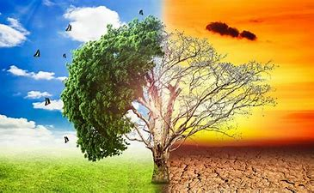

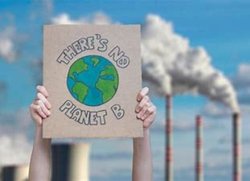

Slide 8
Objectives
To improve awareness and understanding of climate change amongst citizens;
To demonstrate that daily activities can collectively make a big difference and that each individual has a role to play in the fight against climate change; and
To motivate citizens to undertake these small, significant changes to their daily routine.

Slide 9
Literature Survey for Climate change

Slide 10
Review 1
Y
JOURNEL BY MAJOR PROFESSOR: Dr. Leslie A. Duram
Cities are vulnerable to climate change, but they are also uniquely positioned to lead the way in both mitigating and adapting to it. While there is no single solution to climate change, cities have a responsibility to transition toward a more sustainable future.
To examine how climate change is affecting urban areas; to assess how cities can enhance urban sustainability by addressing climate change; to discuss resources available for city leaders wanting to transition to a sustainable city. These objectives are addressed using a literature review cities have a responsibility to transition toward a more sustainable future.

Slide 11
Review 2
JOURNEL BY Students: Fabio Kunckel, Samuel Dennis Mietke, Timur Soroka
Global warming is one area of research that has been steadily increasing in discussions along the last decades. With temperatures increasing around the globe and natural disasters happening in higher frequency, businesses are starting to pay more and more attention to it since it will impact the future of the whole global population, especially in littoral areas and places prone to natural disasters. Since 2010, The objective for this systematic literature review is to generate awareness of what kind of research is being published in the field of climate change and business, within the time frame of 2010 to 2021.

Slide 12
Review 3
JOURNEL BY Stéphanie Jamet and Jan Corfee-Morlot
Climate change is expected to have significant implications for the world economy and, more broadly, for many areas of human activity. The purpose of this review is twofold. First, it is to sumarise current estimates of the impacts of climate change and to explain how these estimates are built in order to identify the main sources of uncertainty and approximation affecting them fond, the paper discusses how this uncertainty should influence policymakers decisions. A main conclusion is that there are large uncertainties in existing estimates of global impacts of climate change in monetary units. .

Slide 13
Review 4
JOURNEL BY Elena Sesana,Alexandre S. Gagnon,Chiara Ciantelli,Joann Cassar,
Climate change, as revealed by gradual changes in temperature, precipitation, atmospheric moisture, and wind intensity, as well as sea level rise and changes in the occurrence of extreme events, is already affecting cultural heritage sites. Accordingly, there is a rapidly increasing body of research reporting on the impacts of climatic stressors on cultural heritage and on the assessment of climate change impacts on cultural heritage assets. This review synthesizes th (1) the cultural heritage exposed to the outside environment, (2) the interiors of historical buildings and their collections

Slide 14
Review 5
JOURNEL BY Bushra Praveen,Pritee Sharma
This paper provides a comprehensive review of various reports, articles documents and papers literature related to the assessment of climate change impacts on crop productivity, and will focus on how climate change and affects agriculture productivity. Agricultural practice is affected by climate changes because of its direct dependence on climatic changes. There are two methods of relationships between agriculture and climate change and has huge significance especially for developing and low-income countries.

Slide 15
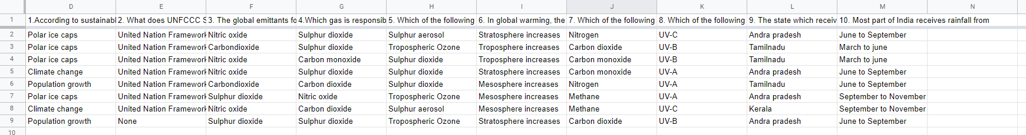

Slide 16
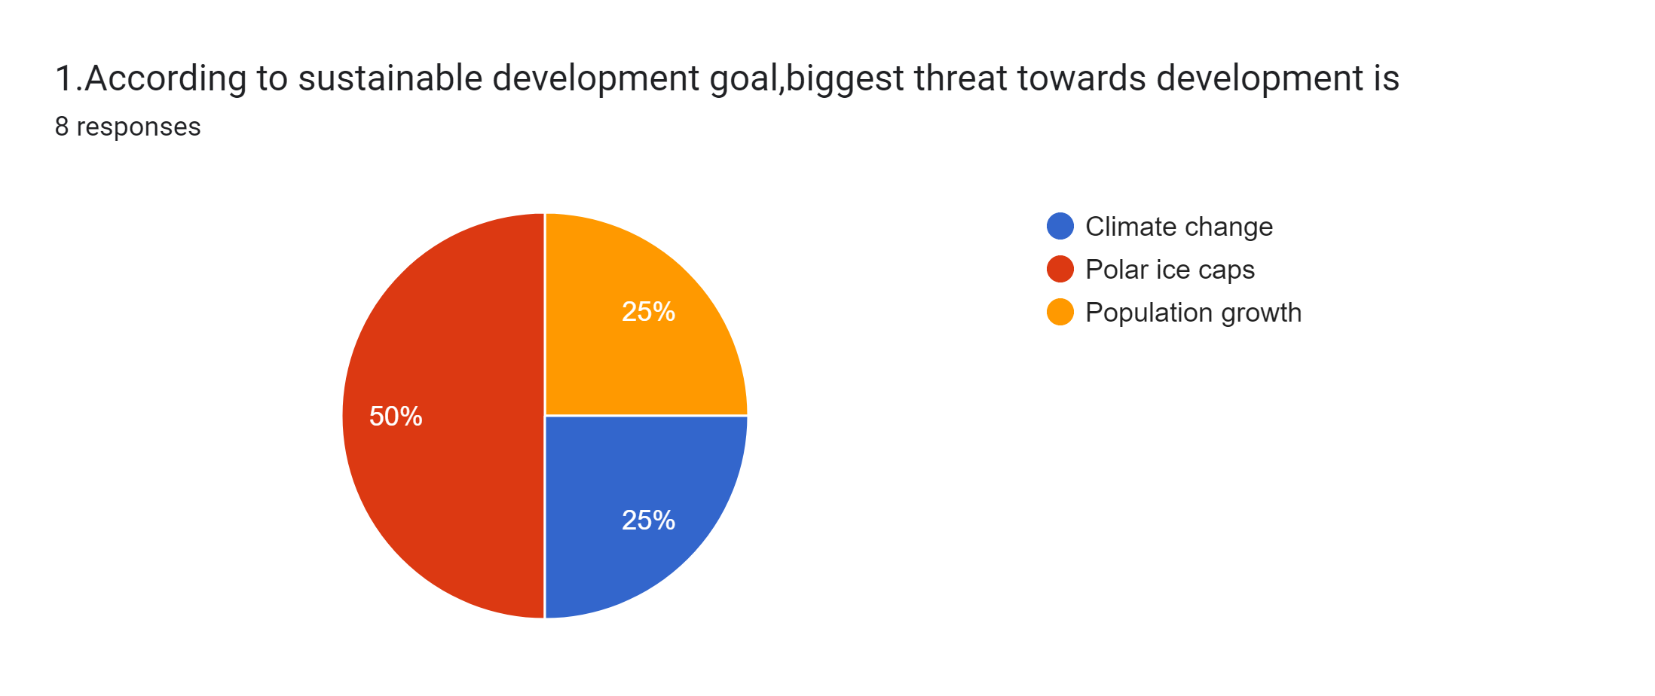
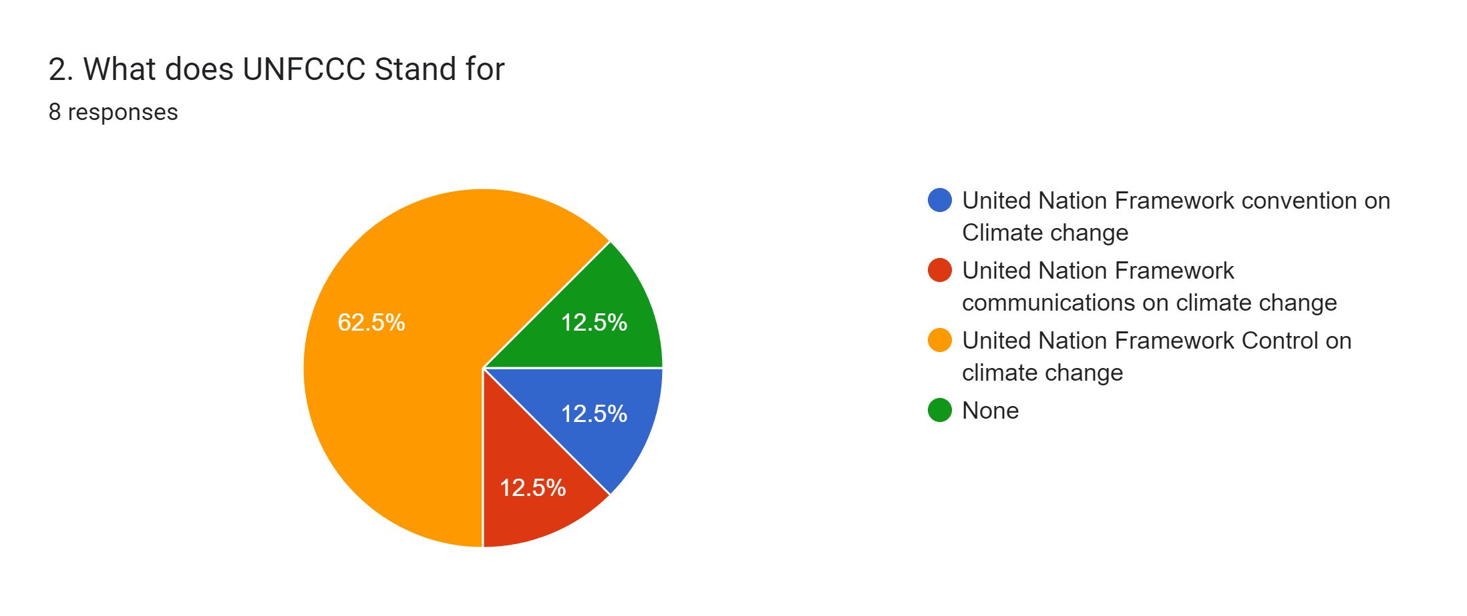

Slide 17
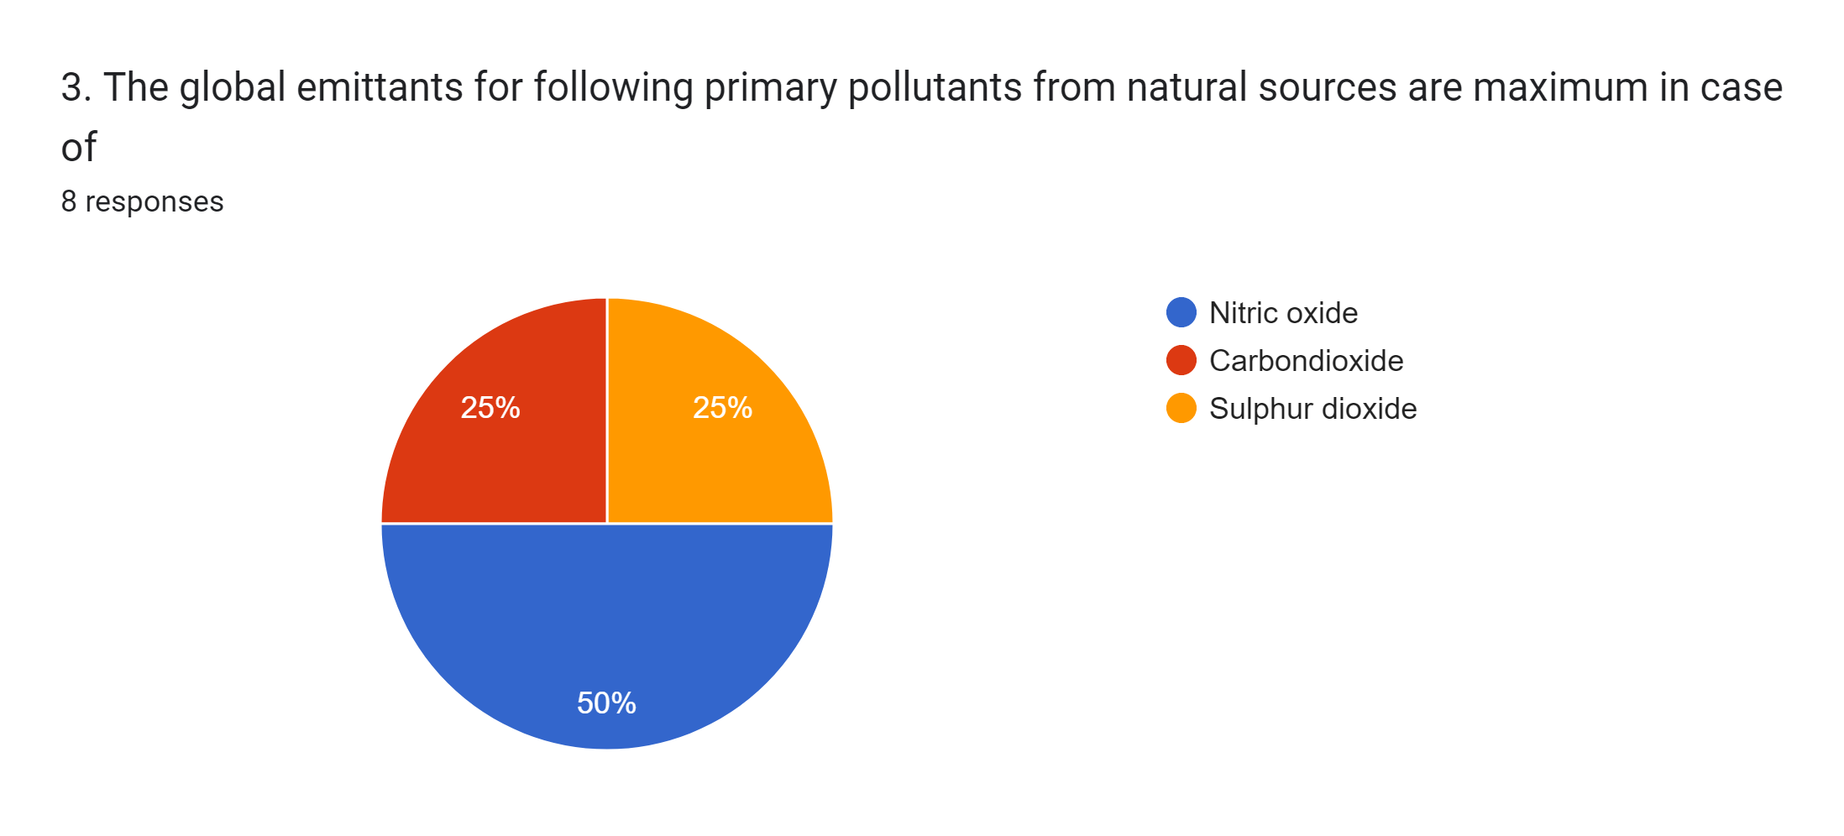
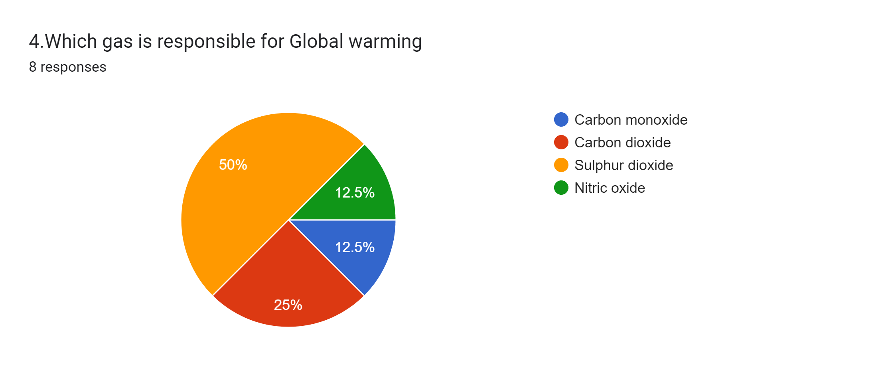

Slide 18
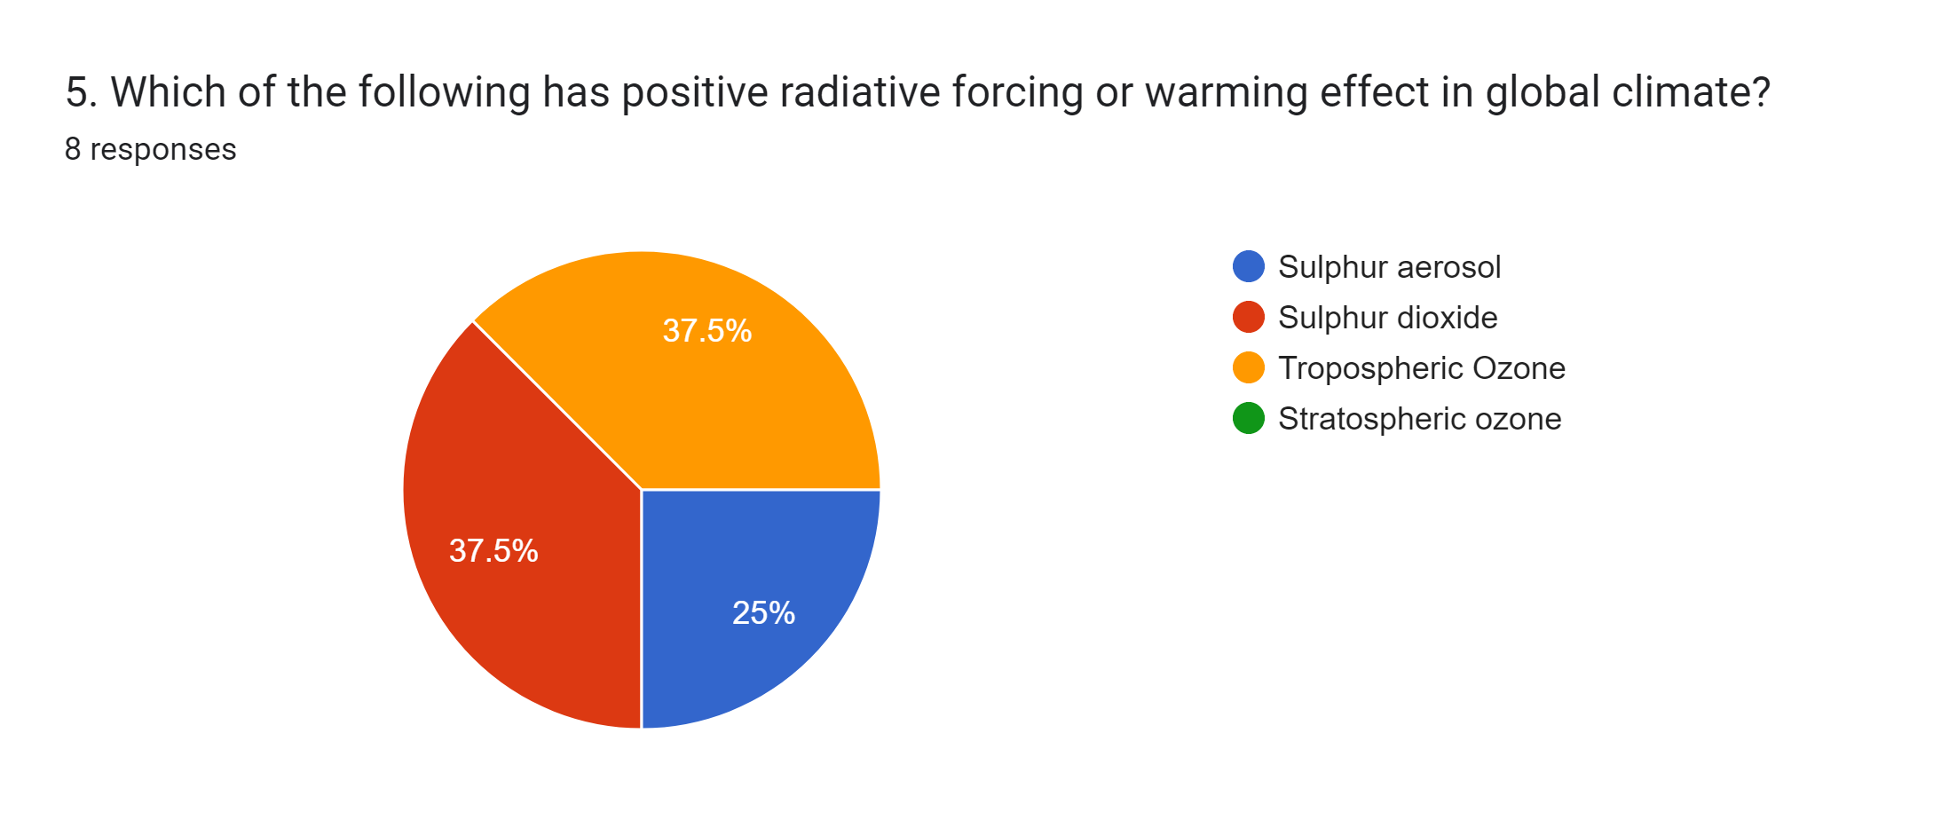
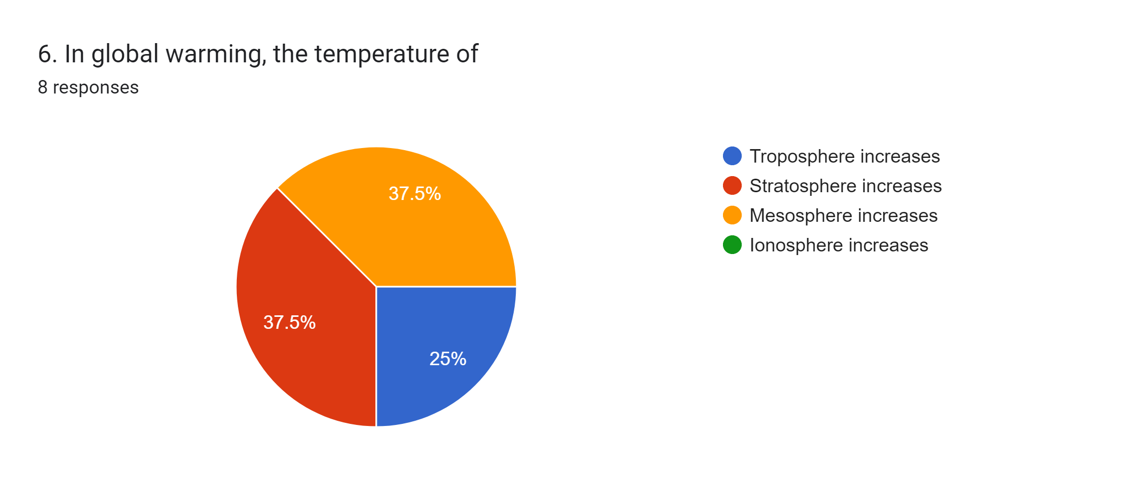

Slide 19
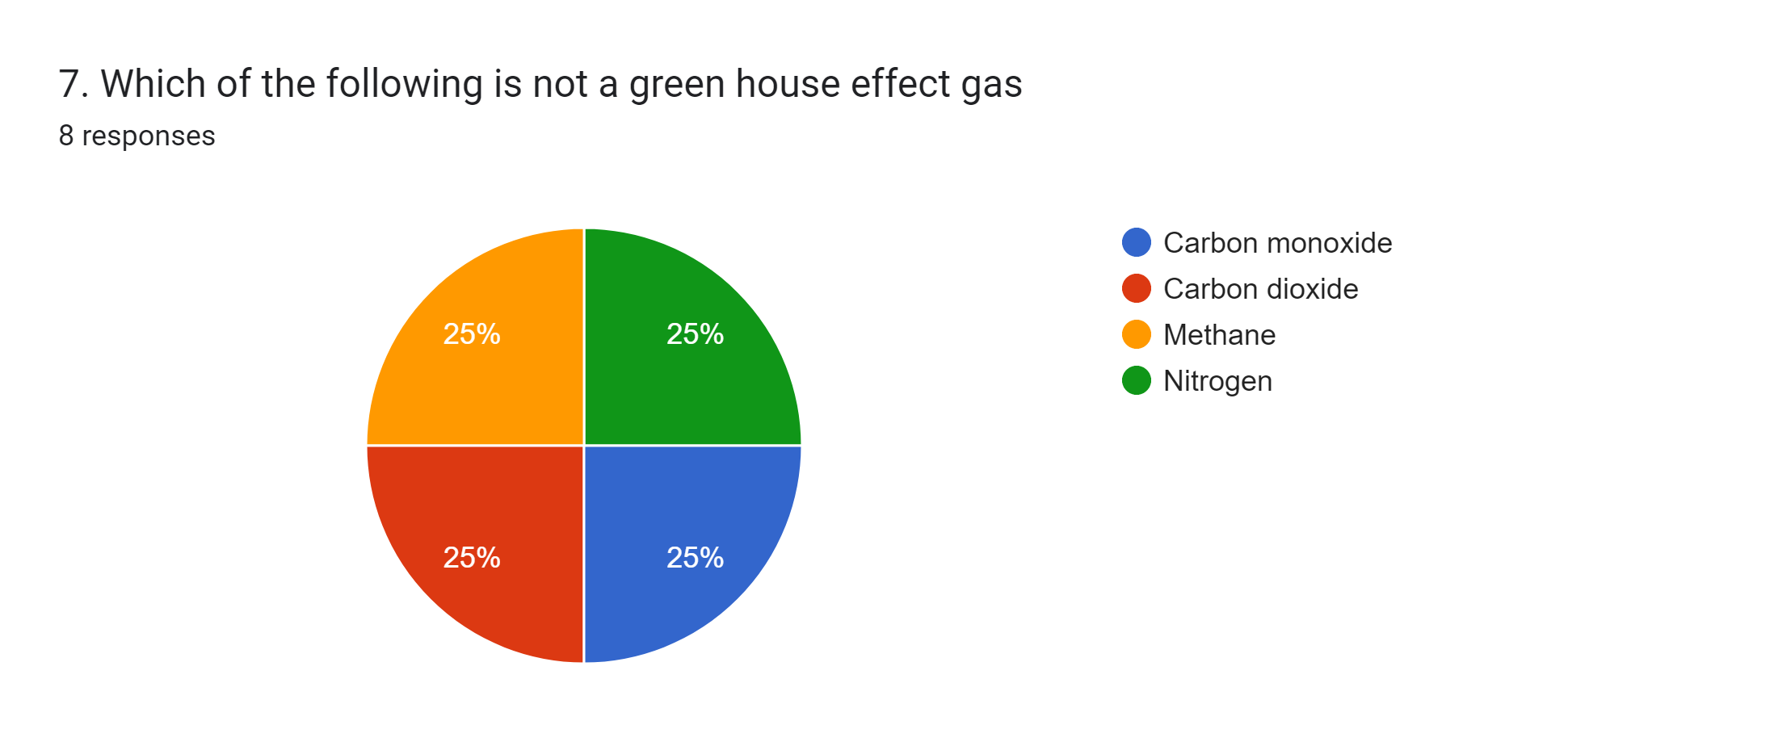
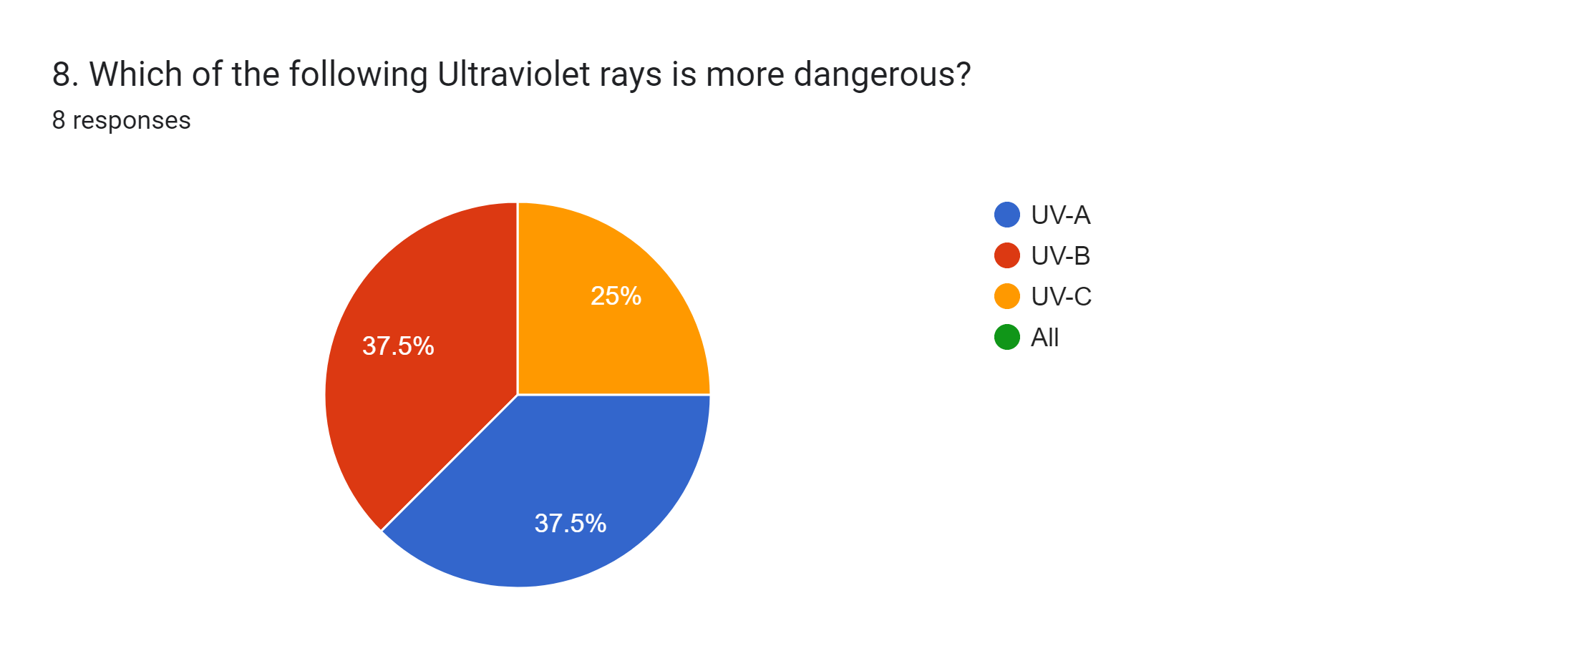

Slide 20
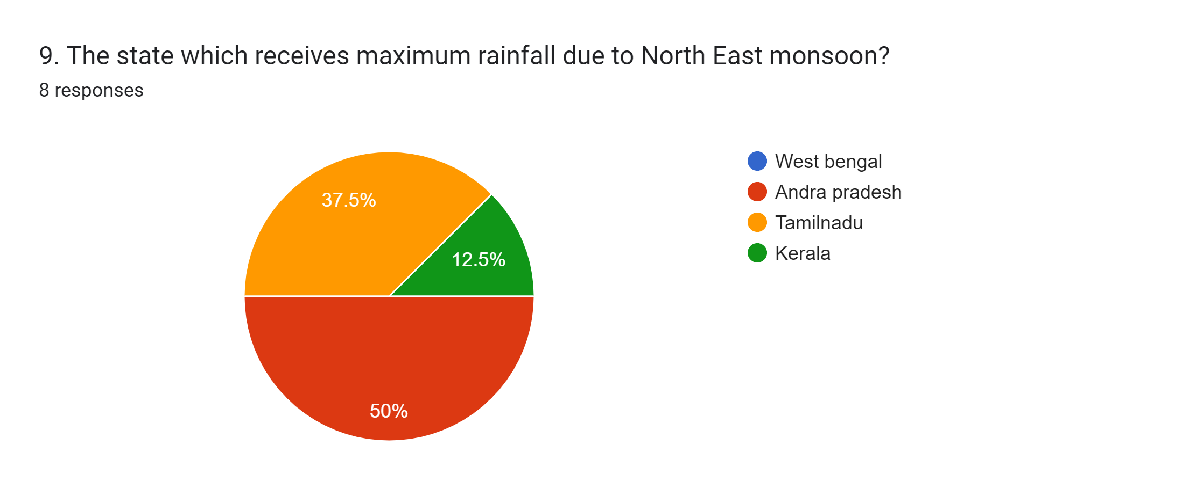
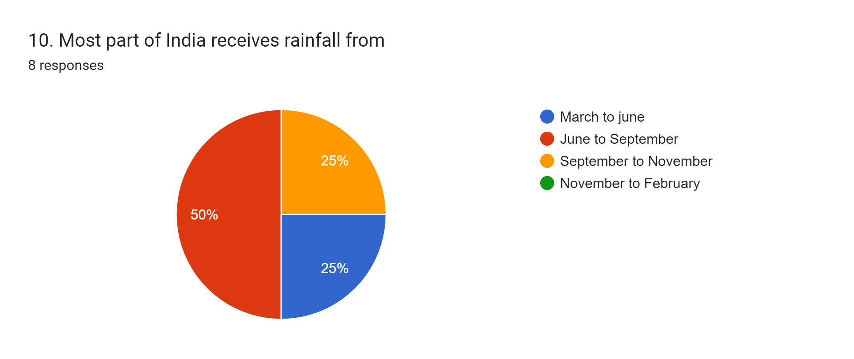

Slide 21
Observation and Result
The Above conducted survey shows that the climate change is carried by Environment
It shows that the survey was effective and friendly
It shows that the Phone cells are promptly answered by the staff
It shows that all the people are getting awareness of the climate change.
It shows that many people are taking initiative to decrease the global warming.

Slide 22
Conclusion
Climate change is happening and it is caused largely by human activity. Its impacts are beginning to be felt and will be worsen in the decades ahead unless we take action. The increasing rate of global warming courtesy of carbon dioxide and other green house gas emissions from human activities have led to climatic changes and environmental degradation, which in turn have resulted to great challenges in relation to diseases and human health. Many diseases which were previously unknown in certain climatic zones are now finding their way to such areas, due to changes in the weather conditions. conditions that favor their comeback.

Slide 23
This kind of diIt is therefore important that stakeholders and decision makers at industrial, government and international policy levels come up with stringent and workable means of cutting down on green house gases emission to combat which has produced devastating impacts especially among poorer nations. Further, there should be increased funding of adaptation and coping programs and projects in affected areas to minimize the impacts on human health and curtail the spread diseases.

Slide 24
References
Climate Change Information Resources, New York Metropolitan Region. http://ccir.ciesin.columbia.edu/nyc/pdf/q1a.pdf
Epstein, P. R. (1999). Climate and Health. Science, 285, 347-348.
Harvard, & Chivian, E. (2002) Biodiversity: Its Importance to Human Health Harvard Medical School.
IPCC Online, Glossary of Terms Used in the IPCC Third Assessment Report (2001) IPCC_Third_Assessment_Report (Accessed December 2009). http://en.wikipedia.org/wiki/
Langford, I. H., & Bentham, G. (1995). The Potential Effects of Climate Change on Winter Mortality in England and Wales
McMichael, A. J., & Githeko, A. Human Health. In: Climate Change 2001: Impacts, Adaptation, and Vulnerability. Contribution of Working Group II to the Third Assessment.
http://www.thegreatwarming.com/pdf/ClimateChangeFactSheet.pdf

Slide 25
Change: Causes, Consequences, and Solutions, Scientific Background to the On-Line Platform Climate Quest.
Rooney, C. et al. (1998). Excess Mortality in England and Wales during the 1995 Heatwave. Journal of Epidemiology and
Community Health, 52, 482-486.
Shindell, D. T. et al. (1998). Increased Polar Stratospheric Ozone Losses and Delayed Eventual Recovery Owing to Increasing Greenhouse Gas Concentrations. Nature, 392, 589592.
Rens Kortmann (CE Delft), Edgar Peijnenborgh (RPS), Judith Harrewijn, Lindske van Hulst (SME Advies) (2007). Climate
http://www.climate-leaders.org/wp-content/uploads/global-climatechange-sudipmitra.pdf
The Argo (2013) Typhoon Haiyan Hits Philippines: Stockton Community Takes Action, The Independent Student .

